Slide 1
Sanganabasu M Herur - 211EC245
Sharath Balaji T - 211EC249
Pitta Manoj - 211EC236
Kunal Kumar - 211EC227
K Pruthvi Raaj - 211EC220

Slide 2







Slide 3


Our Business
Demand Forcast
Table of
Content
Location and menu
Profit and revenue
Cost breakdown
Depreciation
Fixed Cost and Variable cost
Break Even Analysis
Seasonal Demand
Rate of Return

Slide 4

🍵 Welcome to TEA KUDITIYA - Where Every Cup Tells a Story! 🌟
Nestled in the heart of Davangere, we take immense pride in crafting the perfect cup of tea that not only tantalizes your taste buds but also brings warmth to your soul.
At TEA KUDITIYA, we embrace the rich cultural heritage of tea, combining traditional brewing methods with innovative flavors to offer a delightful experience with every sip. Our cozy tea stall is a sanctuary for tea aficionados and casual drinkers alike, providing a serene ambiance to unwind and savor the finest blends.
OUR BUSINESS

Slide 5


Our Team
Sanganabasu M Herur
Sharath Balaji T
Pitta Manoj
Kunal Kumar
K Pruthvi Raaj

Slide 6
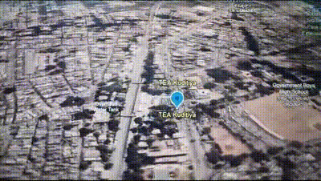


LOCATION
DAVANAGERE
High Foot Traffic Areas
Accessibility
Target Audience
Parking and Convenience
Affordability

Slide 7










open daily
6:30 am - 9:00 pm
MENU
Baa Maga, Tea Kuditiya
TEA
The Chai
Special Tea
tea
masala chai
elachi tea
lemon tea
.........
15/-
20/-
20/-
15/-
.........
.........
tea 20
belladh cha
.........
20/-
20/-
.........
.........
KUDITIYA
Milk
Snacks
boost milk
badam milk
.........
25/-
25/-
milk cookies
bun
rusk *2
.........
05/-
05/-
05/-
.........
.........
.........

Slide 8


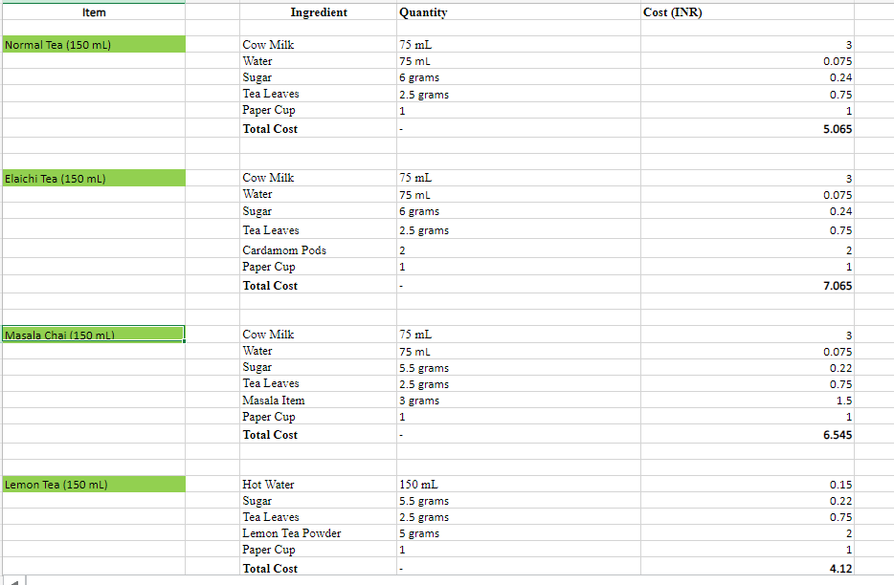
Breakdown of cost
In the cost breakdown analysis shown for each item sold , includes approximate cost of ingredients required for making the item based on the quantity,
basically giving us the cost price of the product.

Slide 9
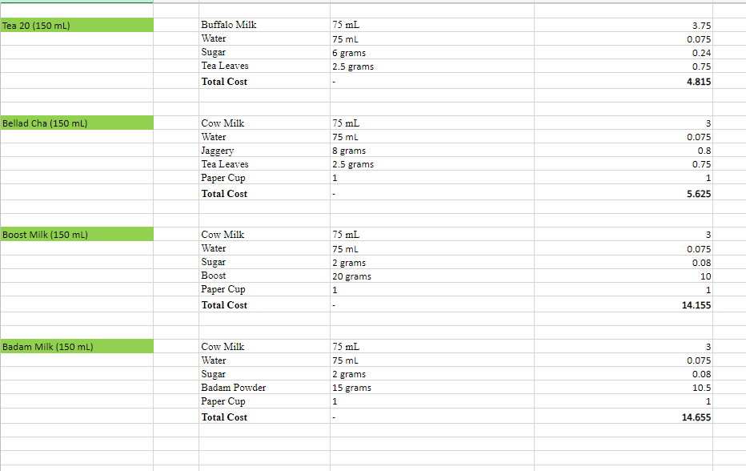
Breakdown of cost

Slide 10
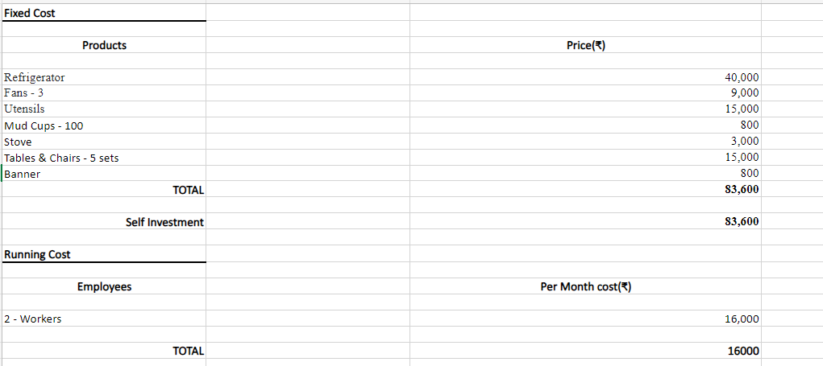
Fixed cost and Variable cost

Slide 11
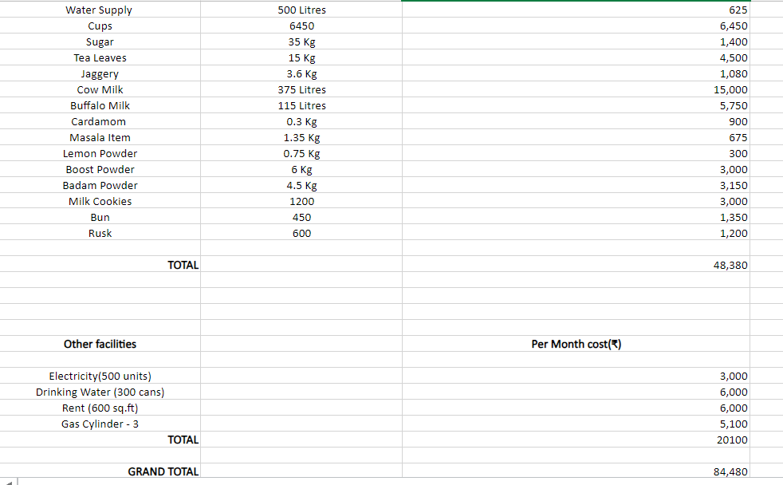
Fixed cost and Variable cost
The fixed cost shown are the initial one time investment which might get depreciated over a given period of time.
The variable cost are the cost that need to be updated or occurs in calculating monthly or weekly revenue and profit

Slide 12
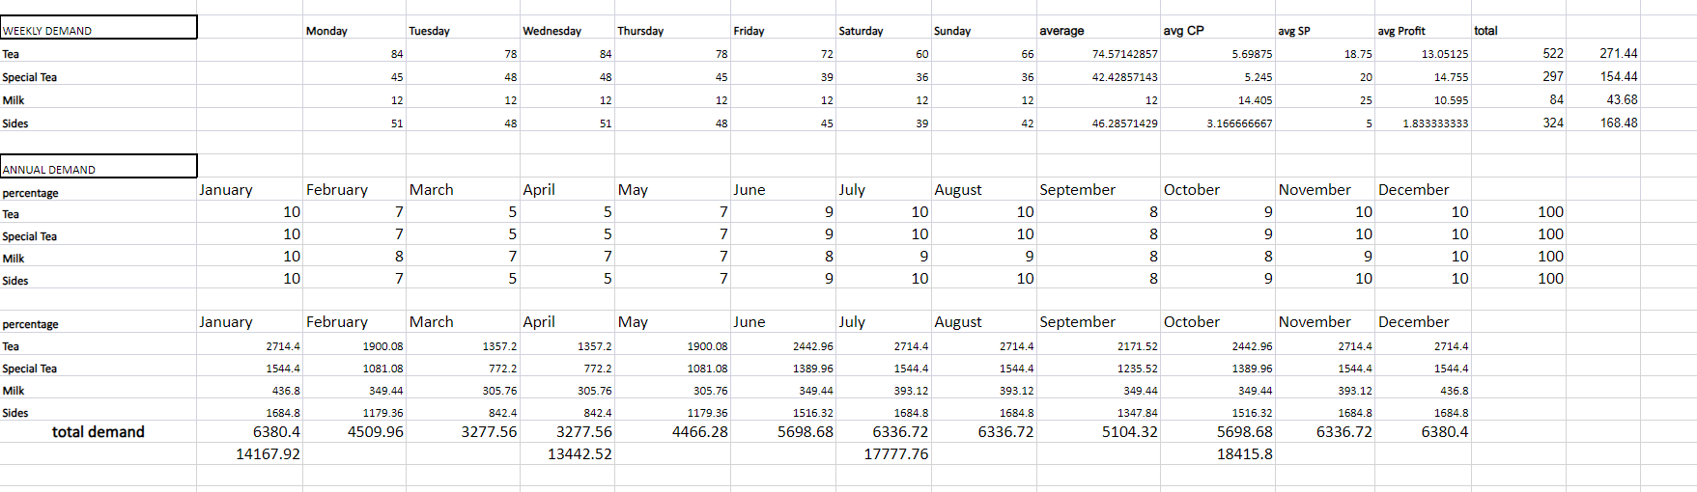
Demand Forecasting
Process of predicting future customer demand for a product or service.
Market Research was done to gain a rough estimate of the demand we would receive.

Slide 13
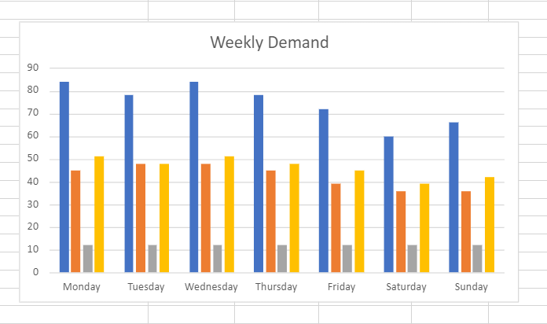
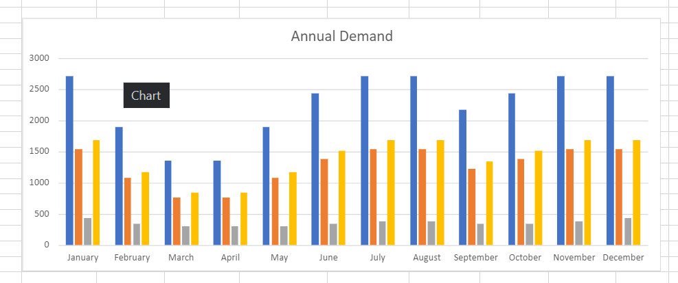
Demand Forecasting

Slide 14
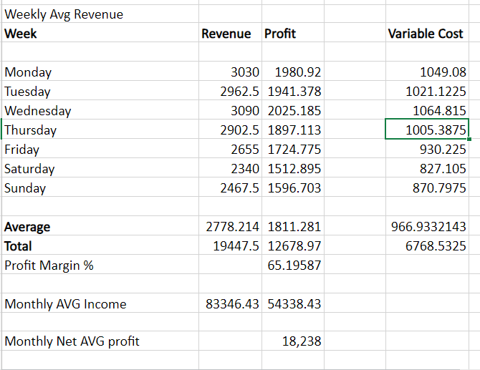
Profit and revenue

Slide 15
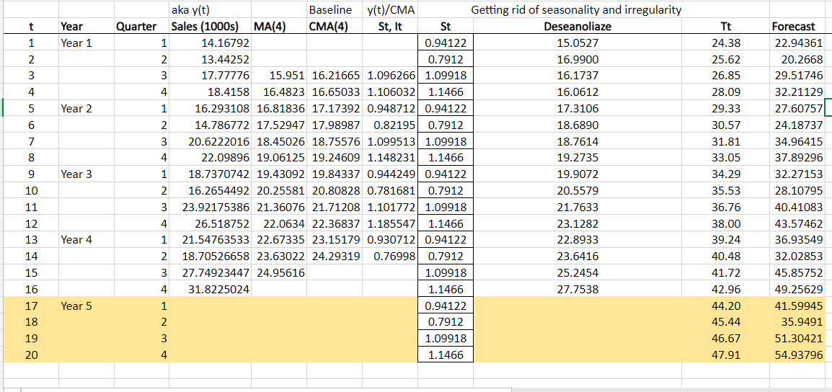
Seasonal Demand

Slide 16
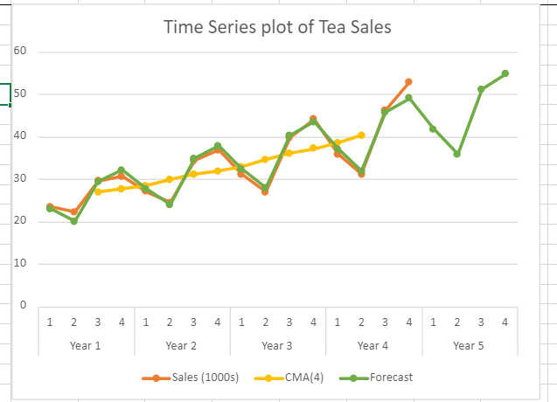
Seasonal Demand

Slide 17
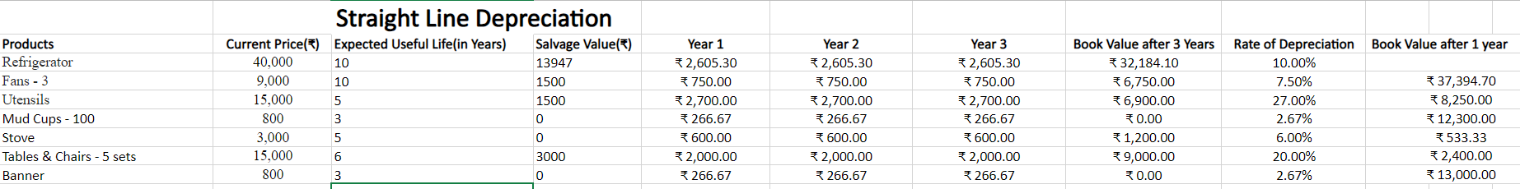
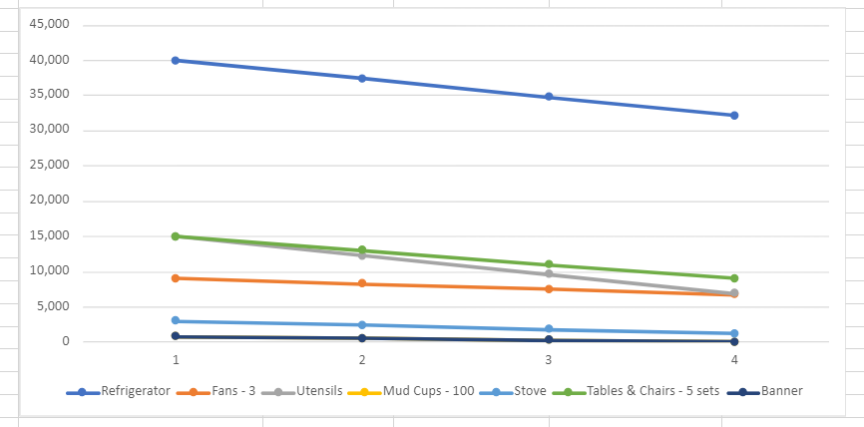
Depreciation
Consider Electric Goods and other essentials for running the business a Straight Line Depreciation Model is designed to analyze Depreciating Assets

Slide 18
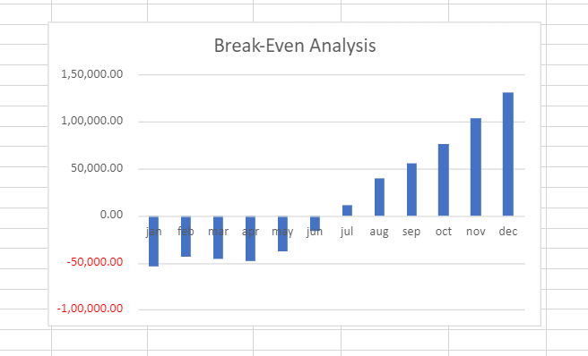
Break-Even Analysis
To determine the break even point
, fixed cost factors, sales price per unit,
variable cost per unit were considered.
With the calculations done considering modest demands, break even is achieved in the third quarter of the first financial year of the business

Slide 19
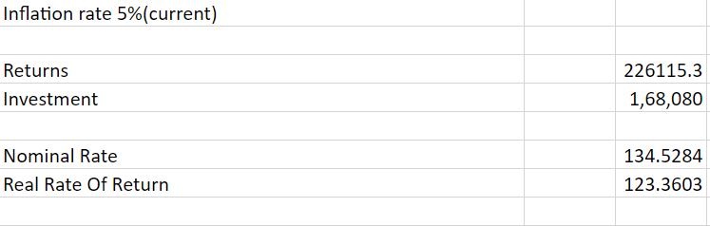
Rate of Return
Considering inflation obtained
Real Rate of return as 123.3603
Nominal return as 134.5284

Slide 20



THANK YOU
open daily
Baa Maga, Tea Kuditiya

